Slide 1
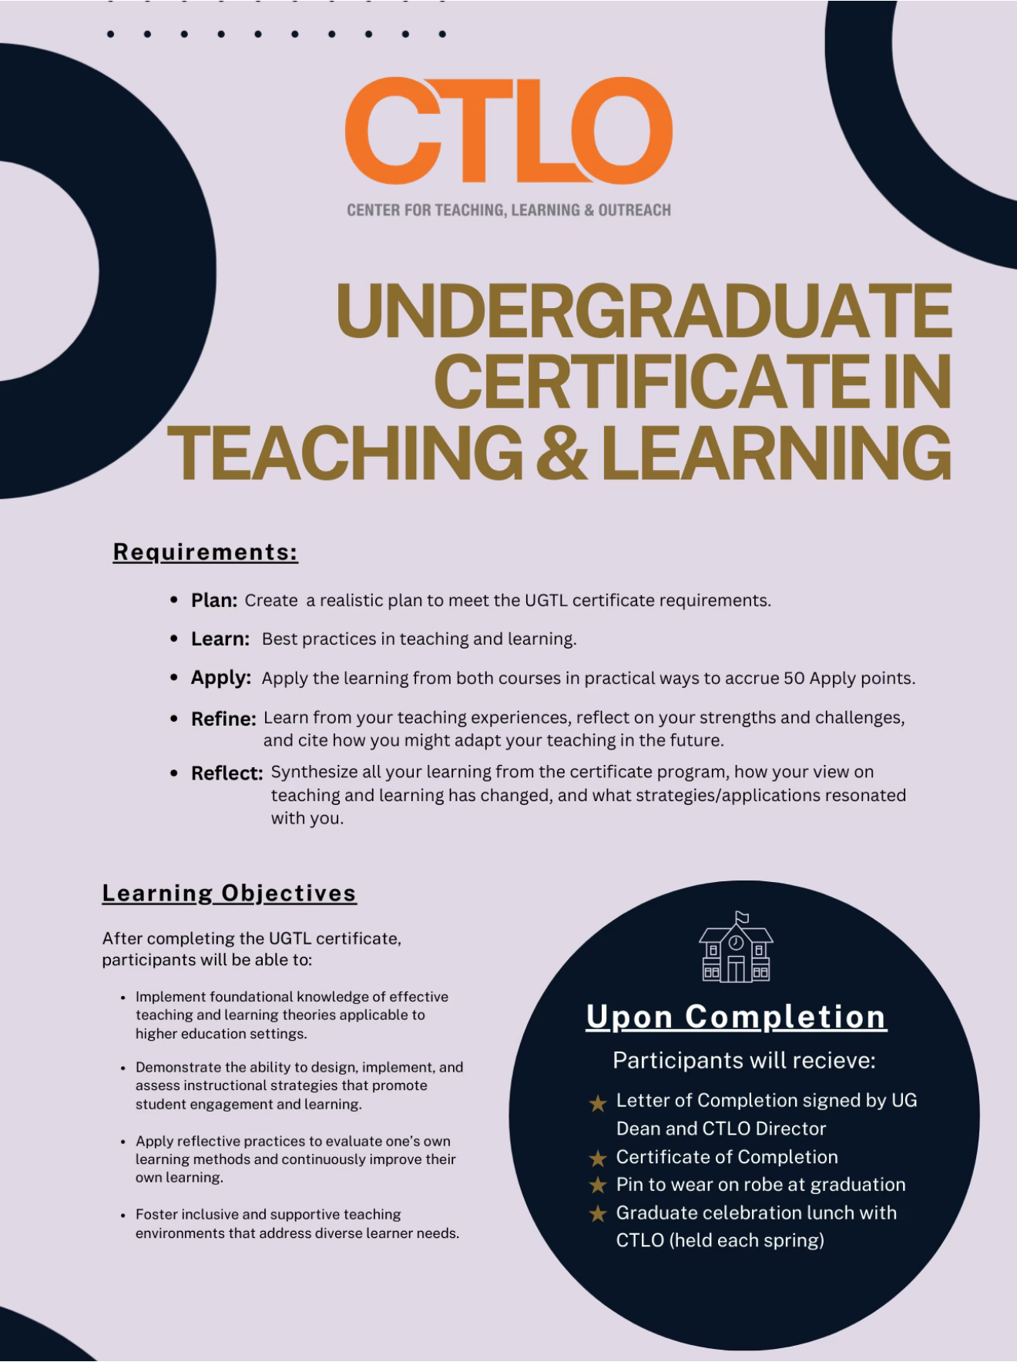
Lunch
Info Session
Please sign in &
help yourself to lunch
Notes:
Welcome
Goal for today – give you a clear picture of what the program is, the requirements, and the overall rationale and philosophy behind the program so that you can make an informed decision about starting it.

Slide 2
What is it?
Catalog Description:
“The Undergraduate Certificate in Teaching and Learning program is designed to introduce participants to research-proven best practices in learning and studying. In addition to improving their own learning strategies, participants learn evidence-based methods for teaching these skills to others.”

Slide 3
What is it?
The UGTL Certificate is designed to equip participants with foundational knowledge and practical skills essential for effective teaching and learning in higher education.
The certificate also emphasizes the creation of inclusive, supportive learning environments that address diverse learner needs, ensuring equitable and student-centered educational experiences.

Slide 4
Learning Goals for Participants
After completing the UGCTL, you will be able to:
Implement foundational knowledge of effective teaching and learning theories applicable to a variety of higher ed settings
Demonstrate
Demonstrate the ability to design, implement, and assess instructional strategies that promote student engagement and learning
Apply
Apply reflective practices to evaluate one’s own learning methods and continuously improve their own learning
Foster
Foster inclusive and supportive teaching environments that address diverse learner needs
Implement

Slide 5
Why should I do it?
The program prepares participants to apply established teaching and learning theories in real academic settings, enabling them to design, implement, and assess instructional strategies that actively promote student engagement and meaningful learning.
Become a more effective PAC, TA, or future faculty member
Improve your skill in conveying ideas clearly and successfully in any situation
Learn more about how learning works, including your own!

Slide 6

What do I get?

Slide 7
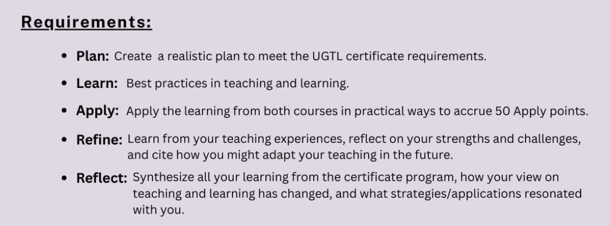
How do I do it?
Through reflective practice, participants develop the ability to critically evaluate and continuously improve their own teaching approaches.
Become a ‘reflective practitioner’: You must purposefully apply what you’ve learned, and thoughtfully reflect on how it went, what you would change, etc.

Slide 8
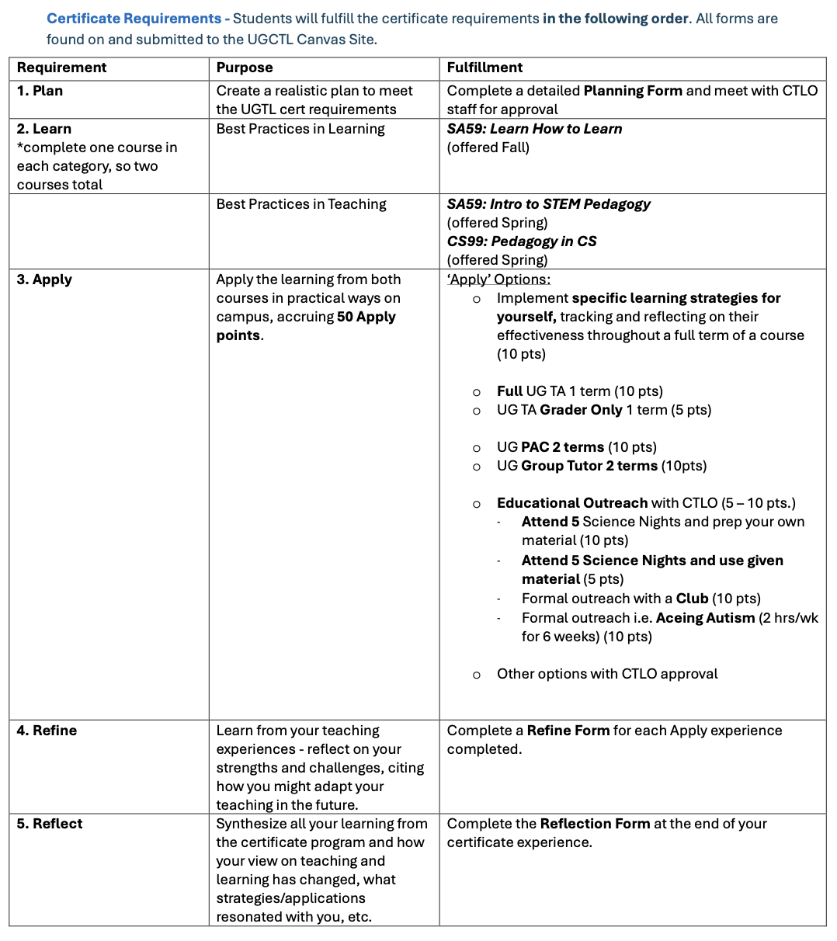
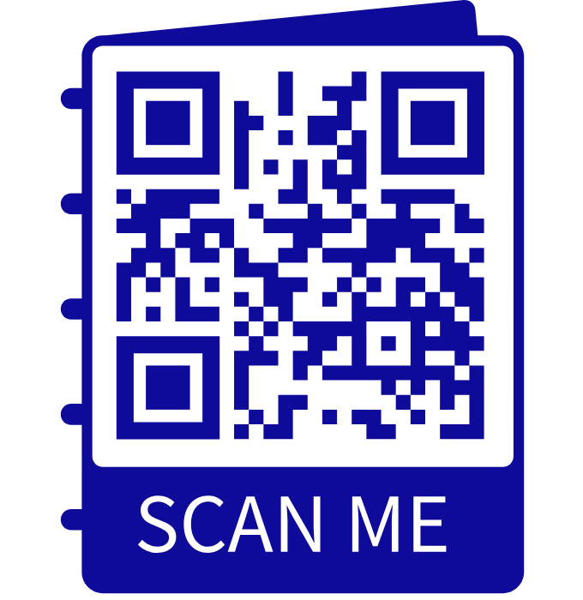
How do I do it?
Through reflective practice, participants develop the ability to critically evaluate and continuously improve their own teaching approaches.

Slide 9
How do I do it?
Step 1: Email CTLO@Caltech.edu to indicate your interest.
Step 2: A link will be sent to you for self-enrolling in the UG Certificate Canvas site.
Step 3: Enroll in the Canvas site and submit the ‘Plan’ form with your detailed plan for how you will complete the Certificate requirements.
Step 4: You will receive feedback from a CTLO staff member on your plan and approval to move forward in the program.

Slide 10
UG Certificate in Teaching & Learning
- Planning Form-
This form is intended to serve as an initial record of how you plan to complete the UG Certificate in Teaching & Learning. This form is not binding and may change as you progress through program (though all major changes must be approved by CTLO staff). This form must be completed and uploaded to Canvas prior to your initial meeting with a CTLO Staff Member.
Name:
Email:
Division:
Date of initial CTLO meeting:
Expected Graduation:
Background
Why are you interested in the UG Certificate in Teaching & Learning? What are your personal goals for the program?
What teaching experiences have you had so far (TA, outreach, tutor, etc)? Please give a brief (2-4 sentence) description of each experience, including your responsibilities, your audience, and any accomplishments you wish to mention.
Have you previously incorporated pedagogy, best practices, or other teaching strategies into your teaching experiences? If yes, please describe briefly.
Learn
How do you plan to fulfill the “learn” requirements of the certificate? When will you do this?
Apply
How do you plan to fulfill the 50 “apply” points of the certificate? Please include expected dates or date ranges for teaching experiences, if possible (e.g. Spring 2027).

Slide 11
Can I use experiences I’ve already completed as my ‘Apply’ points? I’ve already been a PAC, TA, etc.
No.
Through reflective practice, participants develop the ability to critically evaluate and continuously improve their own teaching approaches.
Become a ‘reflective practitioner’: You must purposefully apply what you’ve learned, and thoughtfully reflect on how it went, what you would change, etc.

Slide 12
UG Certificate in Teaching & Learning
- Apply Points Form-
*To be completed BEFORE the start of the ‘Apply’ experience
What is your chosen teaching experience?
What is your role in this experience? What are your responsibilities?
Who are your students? What are their backgrounds (e.g. year in program), what are their goals (major v. non-major), and will you have a mix of students? What opportunities does the makeup of your students offer you as a teacher?
Broadly speaking, what are your pedagogy or best practice-based goals for this experience?
Specifically, what methods would you like to incorporate to achieve these goals? Are there any resources you will need to do this?

Slide 13
Outreach Options

Slide 14
What questions can we answer?

